Slide 1
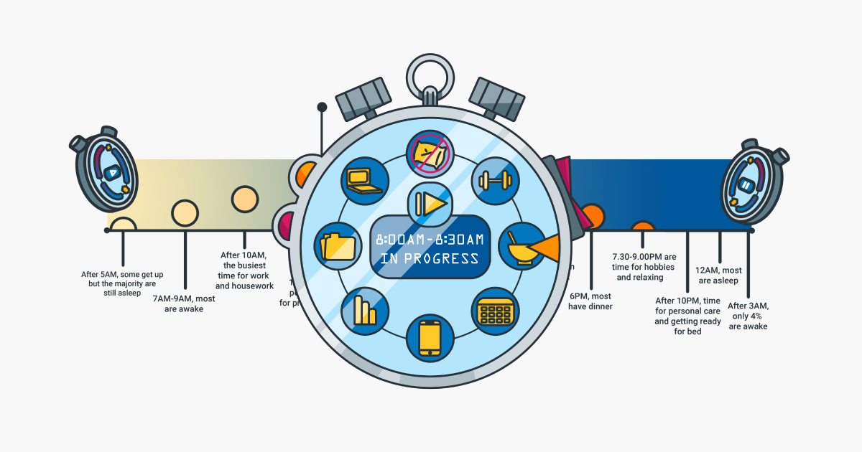

Impacts of leisure time on daily routines
TO STUDY THE IMPACTS OF Lesuire time on daily rountine
Shruti Ushire-906
Aakash Shedge-902
Ranjeet Jadhav-905
Rinku Yadav-919

Slide 2
Table of Contents:
Factor analysis
Statistical
Logistics Classification
Multiple Linear Regression
Text Analysis
Wilcoxon Rank Sum Test
One way anova
Kruskal-Wallis test
Pearson Chi square test

Slide 3
INTROUCTION
Leisure time positively impacts daily routines by reducing stress, improving physical and mental health, enhancing productivity, strengthening relationships, fostering skill development, promoting a balanced lifestyle, and providing cognitive benefit
The benefits of leisure time include:
Stress Reduction: Leisure activities provide relaxation and relief from daily stressors.
Physical Health: Engaging in leisure activities like exercise improves fitness levels and reduces the risk of chronic diseases.
Mental Health: Leisure pursuits boost mood, alleviate anxiety, and enhance overall well-being.
Productivity: Taking breaks for leisure can increase focus and motivation, leading to higher productivity.
Relationship Building: Leisure time spent with loved ones strengthens bonds and fosters communication.
Skill Development: Pursuing hobbies and interests fosters learning and personal growth.
Balanced Lifestyle: Integrating leisure into daily routines promotes a healthier work-life balance.
Cognitive Benefits: Engaging in intellectually stimulating activities maintains cognitive function and mental sharpness.
The impacts of leisure time include:
Improved Well-being: Leisure activities contribute to overall happiness and life satisfaction.
Enhanced Physical Health: Regular engagement in leisure activities promotes. better physical fitness and reduces the risk of lifestyle-related diseases
Better Mental Health: Leisure pursuits alleviate stress, anxiety, and depression, improving mental well-being.
Increased Productivity: Taking breaks for leisure can rejuvenate the mind and increase productivity in other areas of life.
Stronger Relationships: Spending leisure time with friends and family strengthens social bonds and fosters a sense of belonging.
Personal Growth: Leisure activities offer opportunities for learning, skill development, and self-discovery.
Improved Creativity: Engaging in leisure pursuits stimulates creativity and promotes innovative thinking.
Enhanced Quality of Life: Integrating leisure into daily routines leads to a more balanced and fulfilling lifestyle.

Slide 4
Why this topic ??
"Exploring the Impacts of Leisure Time on Daily Routines"
Relevance: Leisure time affects everyone's daily routines, making it a universally relatable topic.
Interdisciplinary: This topic draws from psychology, sociology, health sciences, and economics, providing a comprehensive understanding.
Practical Significance: Understanding leisure's impact informs strategies for work-life balance and mental health promotion.
Growing Interest: Aligns with increasing awareness of well-being and self-care in society.
Research Opportunities: Offers diverse research avenues, allowing for innovative contributions to knowledge.
Personal Connection: Many can relate to balancing work and leisure, fostering engagement and interest in the topic.

Slide 5
Objectives of the study
The objectives of the project can be summarized as follows:
Provide a comprehensive understanding of the factors influencing individuals' daily routines.
Identify opportunities for improvement in daily routines.
Inform the development of targeted interventions aimed at enhancing overall well-being and quality of life.
Analyze how leisure time impacts individuals' daily routines.
Identify factors influencing routines, including decision-making processes, patterns, and associations.
Quantify relationships between leisure time, daily activities, and routine improvement through regression analysis.
Identify demographic correlates associated with routine behaviors.
Analyze textual data to extract insights into individuals' perceptions and attitudes towards daily routines.
Validate findings through statistical testing, ensuring robustness and reliability of results.
Ultimately, aim to contribute to the development of effective strategies and interventions to improve individuals' daily routines and enhance their overall well-being and quality of life.

Slide 6









Methodology
Doing literature and discussions :
Deciding objectives, targeted audience
& prepared questionnaire for data
collection.
Connected with participants & shared
the questionnaire (Google form)
through online mode by messaging &
putting status.
Data stored & then data is prepared for
the analysis using google sheets.
Data is analyzed using visualization
& statistical techniques.
The objectives are fulfilled. All the
findings & insights were recorded in the
form of report. Finally, the project is
successfully completed within time.
6

Slide 7
Data Collection & Preparation
Method for data collection:
I. Questionnaire preparation : by reading various
articles & research papers, doing discussion by
individuals who pursue a side hustle.
II. Survey by circulating questionnaire using
social media like WhatsApp, Instagram, and
Facebook.
III. Convenience sampling: Participants were selected
through a convenience sampling method, which
involves selecting individuals who are easily
accessible and willing to participate.

Slide 8
• Method for data preparation:
I. Feature engineering : merging features
II. Data cleaning: by removing duplicated data & cleaning categorical , open ended questions.
III. Data transformation & formatting: by changing the data types , merging into categories. for e.g.
age into age group, 21, 22, 23 ....... 29, 30 as 21 – 30. similarly, 31 – 40 and 41 – 50.
merging study/ work domain & defining proper categories: Bsc statistics, Statistics,
Mathematics, it as Science. Similarly Commerce, finance, technology, marketing etc were allotted.

Slide 9
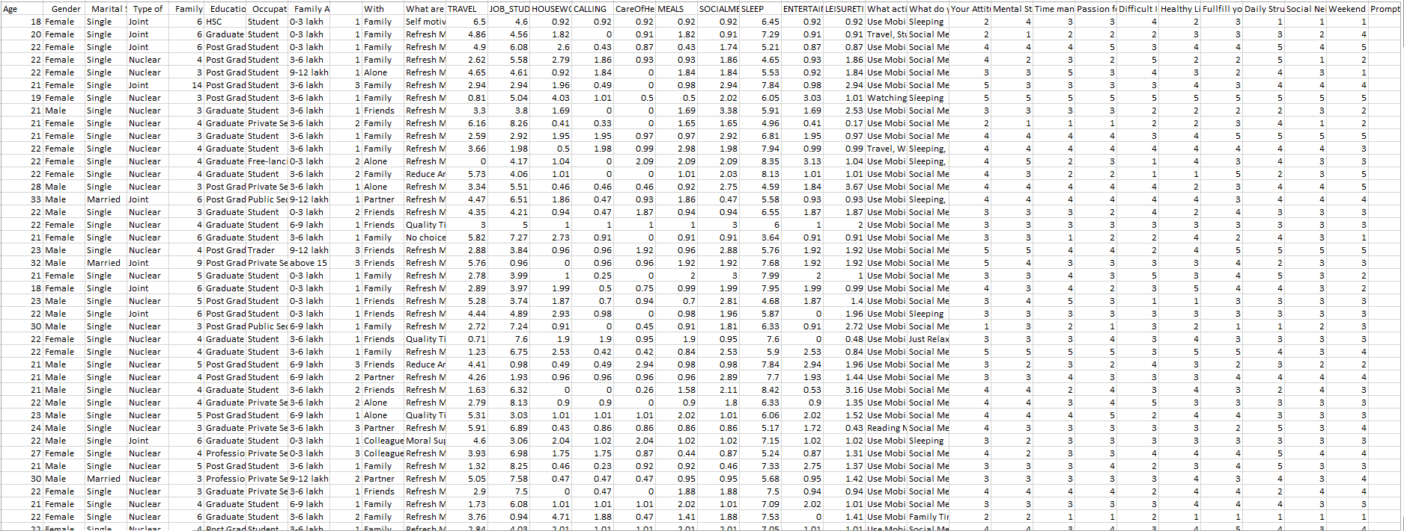
Data Snapshot

Slide 10
Data Visualization

Slide 11
Multiple Linear Regression
Assumption | Technique
Homoscedasticity | A plot of residuals vs fitted values
No Multicollinearity | Variance Inflation Factor
No Outliers | Cook’s Distance
Residuals ~ N (0, σ 2 ) | QQ plot of residuals
No Autocorrelation | A plot of ACF values vs LAG

Slide 12
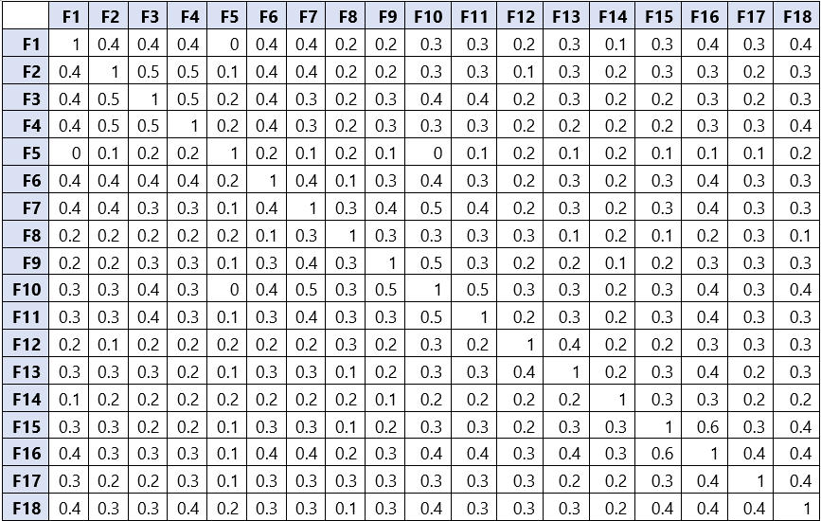
Factor Analysis
The simplest of algorithms in statistics which attempts to predict the relationship between one continuous dependent variable and multiple independent variables.
Correlation analysis
Correlation analysis was carried out to check linear relationship between various variables such as Strained Relationship, Orthodox family pressure etc.
F1) Your Attitude Toward Life | F10) Weekend satisfaction
F2) Mental Stability | F11) Promptness (delaying things)
F3) Time management | F12) Transport facilities
F4) Passion for Living | F13) Environment in your Locality / Area
F5) Difficult Interactions | F14) Unorthodox family
F6) Healthy Life | F15) Sufficient Resources
F7) Fulfill your enjoyments | F16) Fulfilment of desires
F8) Daily Struggle | F17) High Expectations toward life
F9) Dull / Social Neighborhood | F18) Work / Study Environment
From the above table, we can see that there is a linear relationship among variables and hence
assumption of correlation between different variables considered for factor analysis is satisfied.

Slide 13
Objective:-
To determine the factor ability of an intercorrelation matrix we use the KMO and Bartlett's test of Sphericity.
Kaiser-Meyer-Olkin (KMO) measures
KMO test measures the sampling adequacy which should be greater than 0.5. Then, we can say that the sample size is adequate for factor analysis.
Bartlett’s test of Sphericity
Under this test null hypothesis is given by
H0: Population correlation matrix is an identity matrix. (i.e. the variables are uncorrelated)
H1: Population correlation matrix is not an identity matrix.
Kaiser-Meyer-Olkin Measure of Sampling Adequacy | 0.8968
Bartlett’s test of Sphericity | Approx. Chi-Square | 2587.17
 | P - value | 0.00
Here p value is less than 0.05, therefore we reject H0 and conclude that variables are correlated.
Eigenvalues
Eigenvalues are the variances of the principal components. Because we conducted our principal component analysis on the correlation matrix, the variables are standardized, which means that each variable has a variance of 1, and the total variance is equal to the number of variables used in the analysis, in this case, 20.
Component | Eigen Value | Percentage of Variance | Cumulative Percentage
F1 | 5.82865634 | 30.23 | 30.23
F2 | 1.33970978 | 6.95 | 37.18
F3 | 1.25710238 | 6.52 | 43.7
F4 | 1.13161542 | 5.87 | 49.57
F5 | 1.07335646 | 5.57 | 55.14
F6 | 1.00345544 | 5.2 | 60.34
Percentage Of Variance
This column contains the % of variance accounted for by each principal component.
Cumulative Percentage
This column contains the cumulative % of variance accounted by the current and all preceding principal components. E.g.- The 6th row shows a value of 60.34. This means the first 6 components together account for 54.13%.
Scree plot
A scree plot displays Eigenvalues associated with the component of factors in descending order versus the number of components or factors.

Slide 14
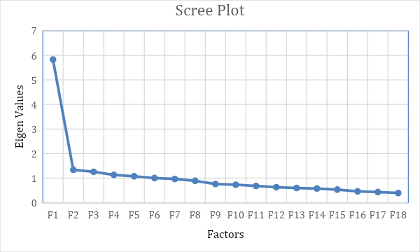
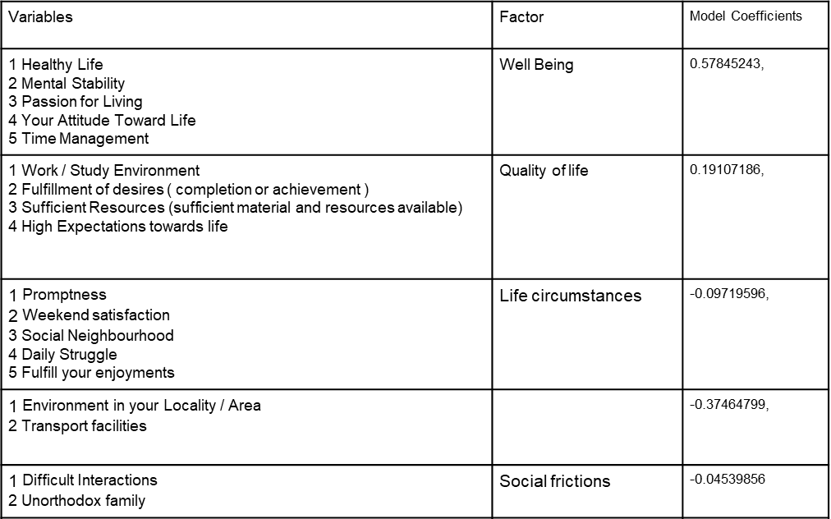
Local Infrastructure

Slide 15
Binary Logistic Regression:
Objective:
To investigate the relationship between predictor variables (Well Being, Quality of Life, Life Circumstances, Local Infrastructure, Social Frictions, Ambitions) and the likelihood of individuals wanting to improve their daily routine.
Conclusion:
Binary logistic regression was conducted to analyze the factors influencing the likelihood of individuals wanting to improve their daily routine. Factors such as Quality of Life, Well Being, Life Circumstances, Local Infrastructure, Social Frictions, and Ambitions were examined. The regression model revealed significant associations between these factors and the likelihood of individuals wanting to improve their daily routine. Further interpretation of the coefficients and odds ratios can provide insights into the magnitude and direction of these associations.
Independent Variables
Well Being
Quality of life
Life circumstances
Local Infrastructure
Social frictions
Ambitions

Slide 16
T-test
Objective:
To assess whether there is a significant difference in mean leisure time between males and females using an independent samples t-test, while ensuring the assumptions of independence and normality are met.
H0: There is no significant difference in the mean leisure time in Female and Male
H1: There is a significant difference in the mean leisure time in Female and Male.
Assumptions:
Normality-
Hypothesis
H0: Data follow normal distribution.
H1: Data does not follow normal distribution.
Shapiro-Wilk Normality test for leisure time in female
W = 0.93623 | p-value = 3.221e-09
Shapiro-Wilk Normality test for leisure time in male
W = 0.90029 | p-value = 2.072e-11
Conclusion:
The independent samples t-test assumptions are met for independence but violated for normality. Since the data does not follow a normal distribution, the Wilcoxon rank-sum test may be more appropriate for comparing mean leisure time between males and females.

Slide 17
Wilcoxon Rank Sum Test
objective:
To determine whether there is a significant difference in median leisure time between different groups using the Wilcoxon signed-rank test, focusing on paired samples or related binary groups.
Assumptions:
Data are paired and come from the same population.
Each pair is chosen randomly and independently.
The data are measured on at least an interval scale when, as is usual, within-pair differences are calculated to perform the test (though it does suffice that within-pair comparisons are on an ordinal scale).
H0: There is no significant difference in the median leisure time in Female and Male. (Mx=My)
H1: There is significant difference in the median leisure time in Female and Male. (Mx≠My)
Wilcoxon rank sum test with continuity correction
Binary Group Variables | Test Statistics | P - Value
Marital Status | 26406 | 0.1135
Type of family | 27599 | 0.6651
Wilcoxon rank sum test with continuity correction
W = 33107 | p-value = 0.1719
Conclusion: The p-value of the test is 0.1719, which is greater than the significance level alpha = 0.05. We can conclude that median leisure time in Female is not significantly different from median leisure time in Male.
Conclusion – The p-value of each binary group variables are greater than the significance level alpha=0.05. Hence, there is no significant difference in categories of each binary group variables.

Slide 18
Objective:
To assess if there's a significant difference in mean daily routine improvement decisions across education levels using a one-way ANOVA test, while ensuring assumptions of homogeneity of variance and normality are met.
One Way ANOVA
Assumptions:
The one-way ANOVA has several assumptions that need to be met for the results to be reliable. The main assumptions are:
· The variances of the dependent variable are equal across the groups.
· The dependent variable is continuous and normally distributed in each group.
· The observations are independent within and between groups.
Education Level
Hypothesis:
H0: The means of all groups are equal.
H1: At least one of the means of the groups is different from the others.
Assumption 2: Are the data from each of the 2 groups follow a normal distribution?
Hypothesis:
H0: Data follow normal distribution
H1: Data doesn’t follow normal distribution
Output-
Assumption 1: The variances of the dependent variable are equal across the groups.
Output-
Levene's Test for Homogeneity of Variance
 | Df | F value | P-value (>F)
group | 5 | 1.0916 | 0.3641
Shapiro-Wilk Normality test
W = 0.92197 | p-value = 2.17e-15
Conclusion:
The p-value obtained from the Shapiro-Wilk test to check the normality of the data is 2.17e-15, which is less than the significance level of 0.05. This indicates strong evidence against the null hypothesis of normality, suggesting that the data is not normally distributed. Therefore, the assumption of normality for the data is violated, and any statistical tests that require normality assumption may not be appropriate to use. In such a case, non-parametric tests such as Kruskal-Wallis test, or Friedman test could be used as alternatives to the parametric tests.
Conclusion: The p-value is not less than the significance level of 0.05. This means that there is no evidence that the variance across groups is statistically significantly different. Therefore, we can assume the homogeneity of variances in the different groups.

Slide 19
Kruskal-Wallis test
Objective:
To determine if there are significant differences in the distribution of a variable among three or more independent groups.
Assumptions:
· Independent samples: The groups being compared are independent of each other.
· Random samples: The data is sampled randomly from the population.
· The dependent variable is measured on an ordinal or continuous scale.
· The shape of the distributions of the groups being compared is not assumed to be normal.
· Homogeneity of variance: The variance of the dependent variable is equal across groups.
Output-
Similarly, for other variables which contain more than two categories.
The hypothesis of the Kruskal-Wallis test is that Hypothesis:
H0: The populations from which the groups are drawn have the same distribution.
H1: At least one population has a different distribution than the others.
Kruskal-Wallis rank sum test
Kruskal-Wallis chi-squared | 40.451
df | 12
p-value | 6.051e-05
Conclusion:-
The p-value obtained from the Kruskal-Wallis test is 0.3315, it indicates that there is significant difference between the groups being compared at the commonly chosen significance level of 0.05. Therefore, we fail to reject the null hypothesis, which states that the populations from which the groups are drawn have the same distribution. The Kruskal-Wallis test has determined that there are significant differences among the groups being compared, performing a Dunn test (or Dunn's post hoc test) is a suitable next step to identify which specific group comparisons are statistically significant.
Kruskal-Wallis rank sum test
 | Kruskal-Wallis chi-squared | Df | p-value
Occupation | 40.451 | 12 | 6.051e-05
Family annual income | 4.9964 | 5 | 0.4163

Slide 20
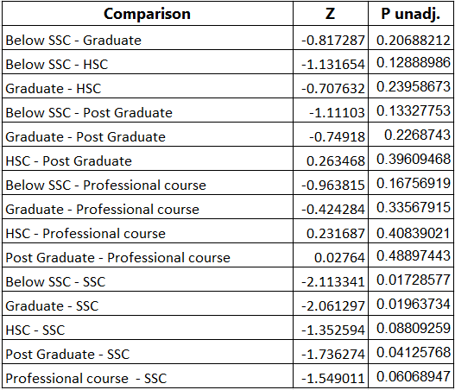
Dunn Test:
The Dunn test, also known as the Dunn's post hoc test or Dunn's multiple comparison test, is a non-parametric statistical test used to perform pairwise comparisons between multiple groups.
Objective:
To assess differences in groups based on occupation and family annual income using statistical tests.
The hypothesis for the Dunn test can be stated as follows:
Null Hypothesis (H₀): There is no significant difference between the two groups being compared.
Alternative Hypothesis (H₁): There is a significant difference between the two groups being compared.
Output:
Conclusion:-No significant difference is found among family income levels. However, there is a significant difference among occupational categories. This suggests that while income levels may not vary significantly, there are notable disparities across different occupations within the studied population.

Slide 21
Chi square test
H0 =there is no relationship between the two variables.
H1 =there is a significant relationship between the two variables.
Level of significance = 0.05
If the p-value is less than the significance level, then the null hypothesis is rejected.
Variables | Factor | Model Coefficients
1 Healthy Life 2 Mental Stability 3 Passion for Living 4 Your Attitude Toward Life 5 Time Management | Well Being | 0.62718733,
1 Work / Study Environment 2 Fulfillment of desires ( completion or achievement ) 3 Sufficient Resources (sufficient material and resources available) | Quality of life | -0.08045541,
1 Promptness 2 Weekend satisfaction 3 Social Neighbourhood 4 Daily Struggle | Life circumstances | -0.27979175,
1 Environment in your Locality / Area 2 Transport facilities |  | 0.10157275,
1 Difficult Interactions 2 Unorthodox family | Social frictions | -0.31358579,
1 High Expectations towards life 2 Fulfill your enjoyments | Ambitions | 0.53554898
Variable 1 | Variable 2 | P value
Gender | Daily routine improvement | p-value = 0.0004249
Marital Status | Daily routine improvement | p-value = 2.488e-05
Type of family | Daily routine improvement | p-value = 0.0001566
Education level | Daily routine improvement | p-value = 3.114e-05
Occupation | Daily routine improvement | p-value = 0.001747

Slide 22
Chi - Square Test
A chi-square test is a statistical test that is used to compare observed and expected results.
Objective:
To examine the association between demographics (gender, marital status, type of family, education level, and occupation) and individuals' decisions regarding daily routine improvement using the chi-square test.
Hypotheses:
Null Hypothesis (H0): There is no association between the categorical variables.
Alternative Hypothesis (H1): There is an association between the categorical variables.
Variable 1 | Variable 2 | P value
Gender | Daily routine improvement | p-value = 0.0004249
Marital Status | Daily routine improvement | p-value = 2.488e-05
Type of family | Daily routine improvement | p-value = 0.0001566
Education level | Daily routine improvement | p-value = 3.114e-05
Occupation | Daily routine improvement | p-value = 0.001747
Conclusion:
In the results of the chi square test we can see that the decision of the daily routine improvement of the individuals has a significant relationship with all the demographics of the individuals.

Slide 23
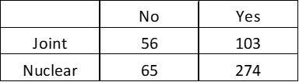
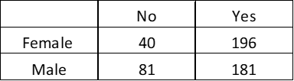
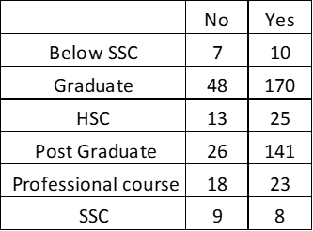
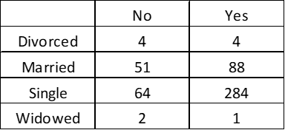
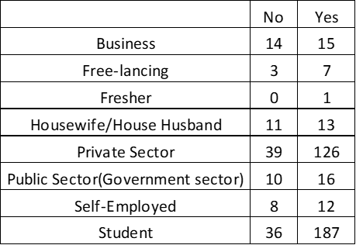
Contingency tables:
Type of Family - Daily routine improvement
Gender - Daily routine improvement
Education level - Daily routine improvement
Marital Status - Daily routine improvement
Occupation - Daily routine improvement

Slide 24
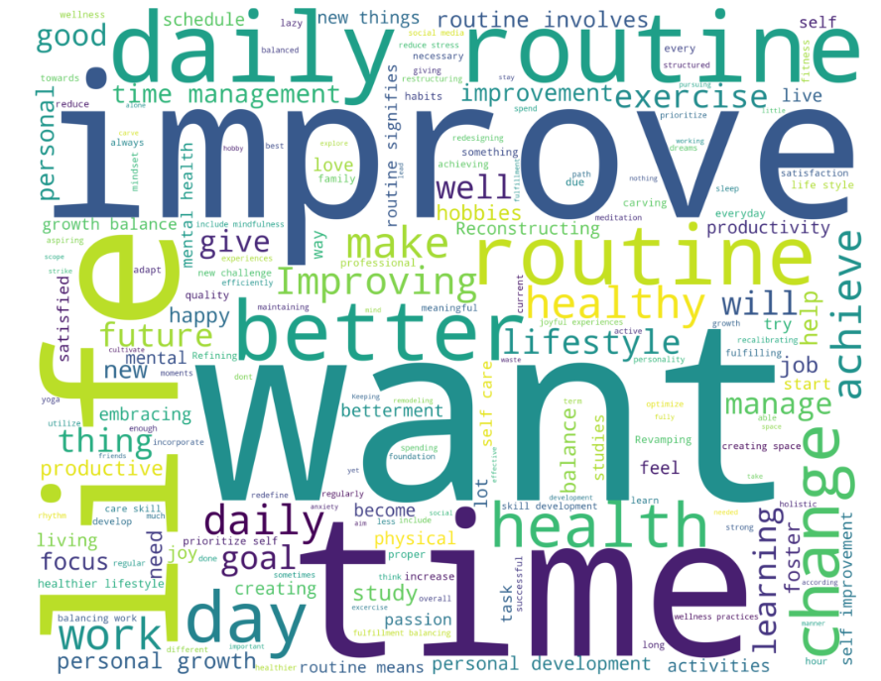
Text Analysis
This graph shows that of the different emotions expressed, still most of them have been expressed in a positive way and very few in a negative way as to form a response and submit their choice.
The above word cloud highlights the words like IMPROVE, daily routine,better life ,time etc. the most as compared to other words.
1. This shows that these large sized words have been expressed the most by the people in their responses.
2. Some sort of improvement is required by them in their routines which may be due to any reasons.
3. They are stressed by something and the reason for that may be productivity lacking in their tasks.
4. People want to enjoy a healthy lifestyle and have fun. They be doing something in a proper fashion etc. This gives a clear idea about the responses.

Slide 25
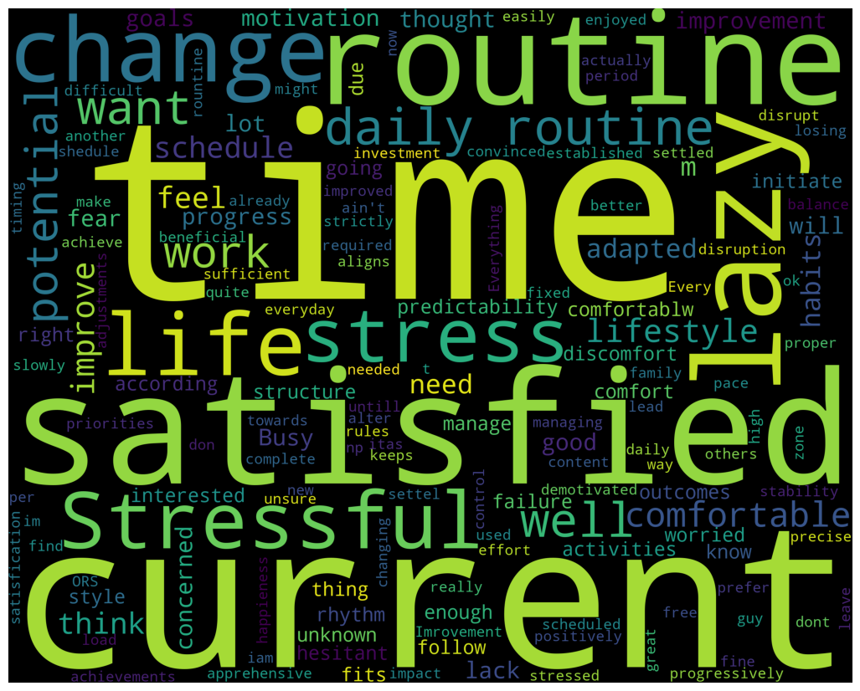
The above word cloud highlights the words like change rountine, stressful,change rountine ,lazy etc. the most as compared to other words

Slide 26
Factor Analysis: Identified major factors influencing daily routines, such as Quality of Life, Well Being, Life Circumstances, and Social Frictions. This provides a structured understanding of the underlying variables affecting individuals' routines.
Logistic Classification: Achieved a model accuracy of 66%, indicating moderate success in predicting factors influencing the decision to improve daily routines. Further refinement of the model could enhance predictive accuracy.
Association Rule Analysis: Revealed significant patterns of activities associated with individuals seeking improvement in their routines. Suggestions included engaging in activities like going for a walk, spending time with family, and listening to music for better routine management.
Multiple Linear Regression: Highlighted the negative impact of various daily activities like travel, work/study, housework, etc., on leisure time. Understanding these relationships can aid in prioritizing activities for a more balanced lifestyle.
Decision Tree Analysis: Identified demographic characteristics such as family size, occupation, and income level that correlate with the need for routine improvement. This offers insights into target groups for interventions aimed at enhancing daily routines.
Text Analysis: Analyzed sentiments expressed by individuals, indicating a desire for improvement in routines. Positive sentiments like "improve," "better life," and "time" were predominant, suggesting a proactive approach towards lifestyle enhancement.
Statistical Tests: Conducted various tests including t-test, Wilcoxon Rank Sum Test, One Way ANOVA, Kruskal-Wallis Test, and Pearson Chi-Square Test to explore relationships between variables. These tests provided evidence of significant differences and relationships among variables such as gender, marital status, education level, occupation, and family income.

Slide 27
Conclusion:
There is a clear need and desire among individuals to improve their daily routines, driven by factors like quality of life, well-being, and social circumstances.
Demographic characteristics play a significant role in determining the need for routine improvement, highlighting the importance of targeted interventions.
Future research could focus on developing more sophisticated predictive models, exploring additional variables, and conducting longitudinal studies to track changes in routines over time.

Slide 28
Future scope
Conduct Further Research on Underrepresented Demographic Groups: Explore routine behaviors and intervention effectiveness among demographic groups that may have been underrepresented in the initial analysis, such as minority populations, individuals with disabilities, or elderly individuals. This will ensure that interventions are inclusive and address the diverse needs of all segments of the population.
Investigate Cultural Influences on Daily Routines: Examine how cultural factors shape individuals' daily routines and their receptiveness to interventions. This could involve conducting cross-cultural studies to identify cultural norms and practices that impact routine behaviors, as well as adapting interventions to suit different cultural contexts.
Explore Technological Solutions for Routine Improvement: Investigate the use of technology-driven solutions, such as habit-tracking apps, smart home devices, or virtual assistants, to facilitate routine improvement. Explore how these tools can be integrated into individuals' daily lives to promote behavior change and enhance overall well-being.
Collaborate with Employers and Organizations: Partner with employers, community organizations, and healthcare providers to implement workplace wellness programs and community-based initiatives aimed at supporting individuals in improving their daily routines. This could involve offering incentives, resources, and support networks to encourage behavior change and sustain healthy habits.
Evaluate Policy Interventions: Assess the impact of policy interventions, such as flexible work arrangements, urban planning initiatives promoting walkability and access to green spaces, or regulations limiting screen time, on individuals' daily routines and well-being. Evaluate the effectiveness of these interventions in promoting healthier lifestyles at a population level.
Conduct Longitudinal Studies: Follow individuals over an extended period to track changes in their routines, behaviors, and well-being. Longitudinal studies can provide valuable insights into the long-term effects of routine improvements and help identify factors that contribute to sustained behavior change over time.
By addressing these additional points in future research and interventions, stakeholders can further enhance our understanding of daily routines and develop effective strategies to promote healthier, more fulfilling lifestyles for individuals across diverse demographic groups.

Slide 29
References
https://www.tandfonline.com/doi/full/10.1080/16078055.2023.2287226?src=
https://eurapa.biomedcentral.com/articles/10.1186/s11556-016-0170-2

